Slide 1
Community Basics:
Exploring the Help Pages

Slide 2
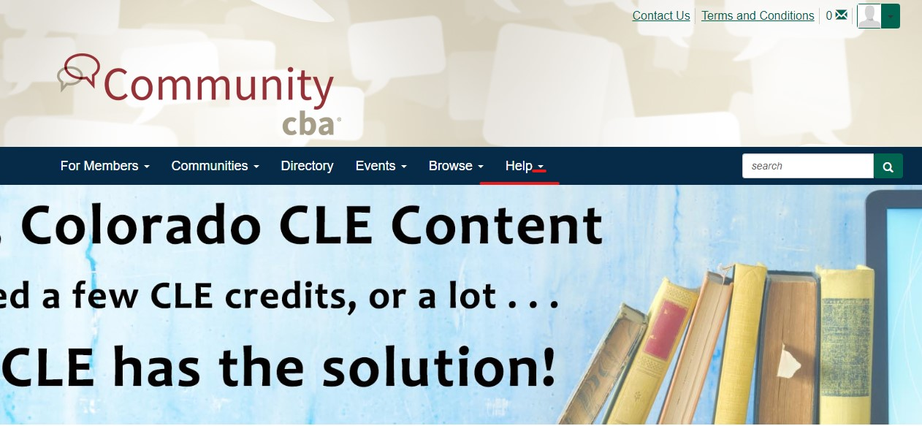
Located in the top banner, click the arrow next to ‘Help’

Slide 3
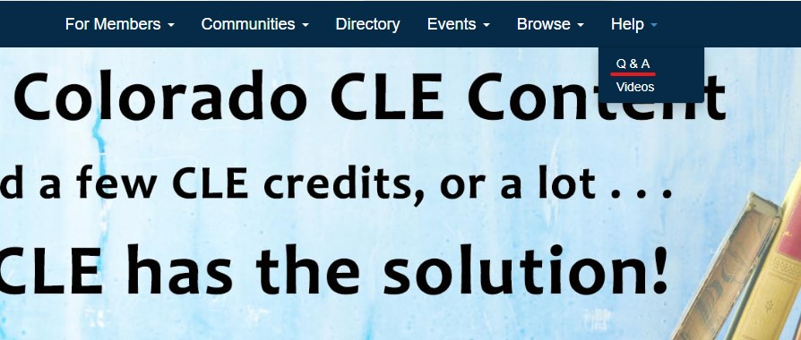
There are two different options to choose from, the first is the Q & A page:

Slide 4
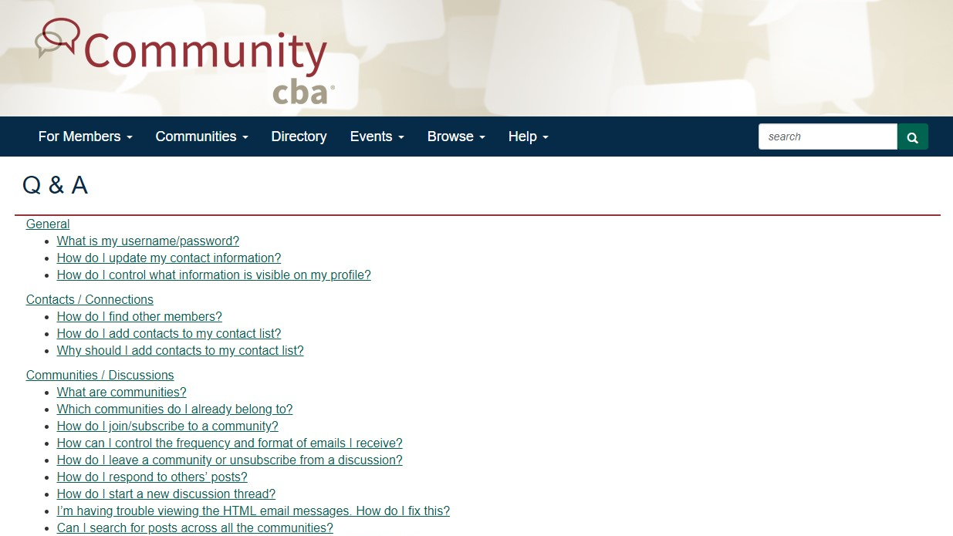

Slide 5

The second is the Video page:

Slide 6
